Slide 1

Module 6 Group presentation
Submitted by:-
Aanchal Bump
Chayan Jaiswal
Rambhupal Payyavula
Samarth Yadav
Hang Wu

Slide 2
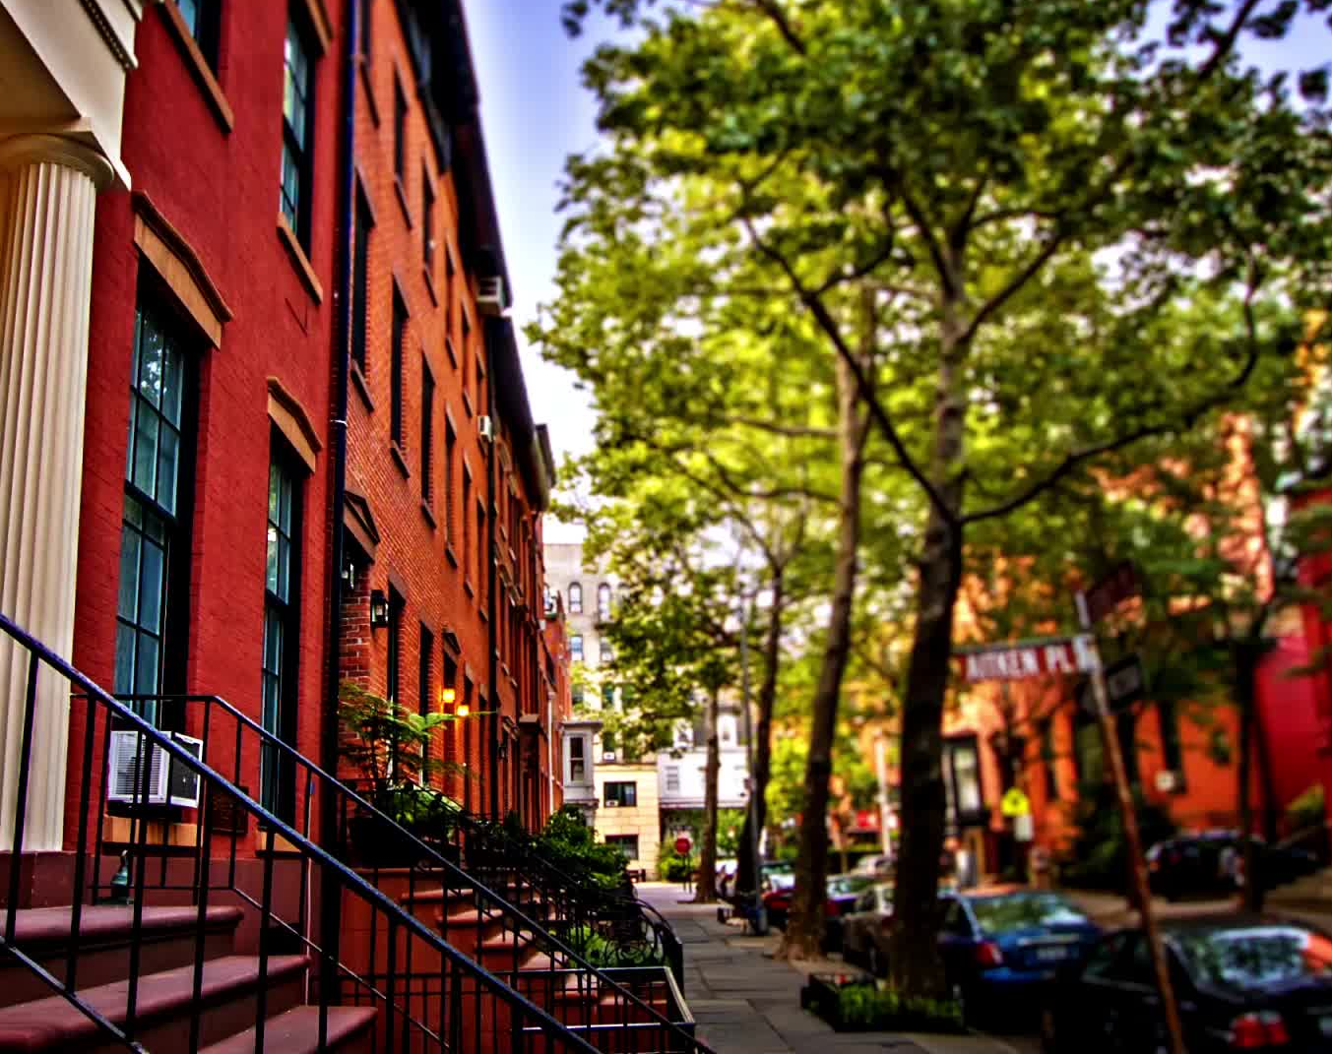
Trees in New York

Slide 3
Introduction
Urban trees play an essential role in providing shade, pollution removal, stormwater runoff reduction, and recreational and aesthetic advantages.
There are even many more benefits that we unknowingly get from the trees in our daily lives. It is vital to take care of existing trees and plant new trees.
In this presentation, we will be discussing the tree’s health, status, problems in different boroughs in New York City. We will also be discussing the records created by different users, top species and tree sidewalks, average diameter.
We will be present to National Urban and Community Forestry Advisory Council (NUCFAC) to take to take necessary actions to save the trees.

Slide 4
Questions
What is the health and status of trees in 2015 & 2016?
Top 12 species and their stump diameter and total number of sidewalk in New York city?
What is the distribution of Records created by different users?
What are the most common Problems faced by Trees?
How are the trees in the NYC affected by their health and status ?

Slide 5
About The Dataset
We have taken the 2015 Street Tree Census - Tree Data for analysis. This dataset comprises 683,788 observations and 45 variables that describe different details of the tree.
Based on our business questions, we will mainly focus on the health, status, problems, and data of trees. So below are the variables of interest that we choose to analyze the data.
Variables:
Tree Id: Numerical variable that describes the unique identification number of each tree Zip City: String variable that represents the city where the trees are located Problems: The string variable describes different types of issues faced by the trees across New York according to the 2015 census. Health: String variable that describes the health if it is poor, good, or fair Created At: The date variable describes when the trees data point is collected in the census software. User type: The string variable describes the different categories of users who collected the tree data point. Status: String variable that describes the status of the tree; if it is alive, dead, or Stump. Borough: String variable that represents the borough where the trees are located. spc_common: String variable that represents the common name of the species.

Slide 6
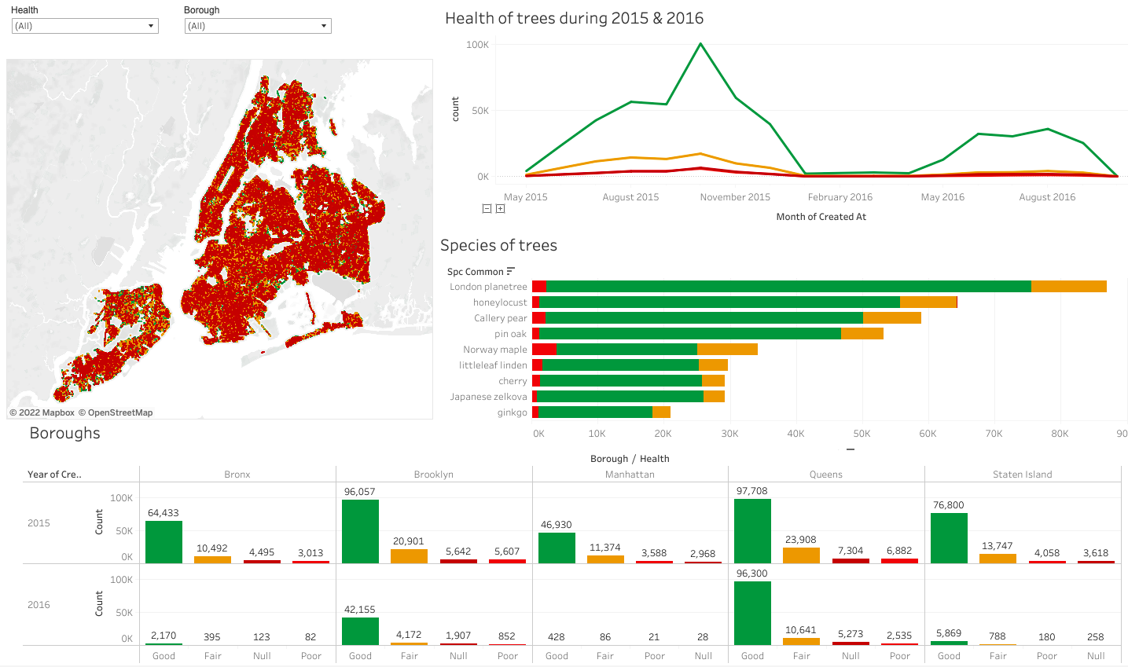
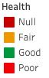
HEALTH OF TREES in 2015 & 2016

Slide 7
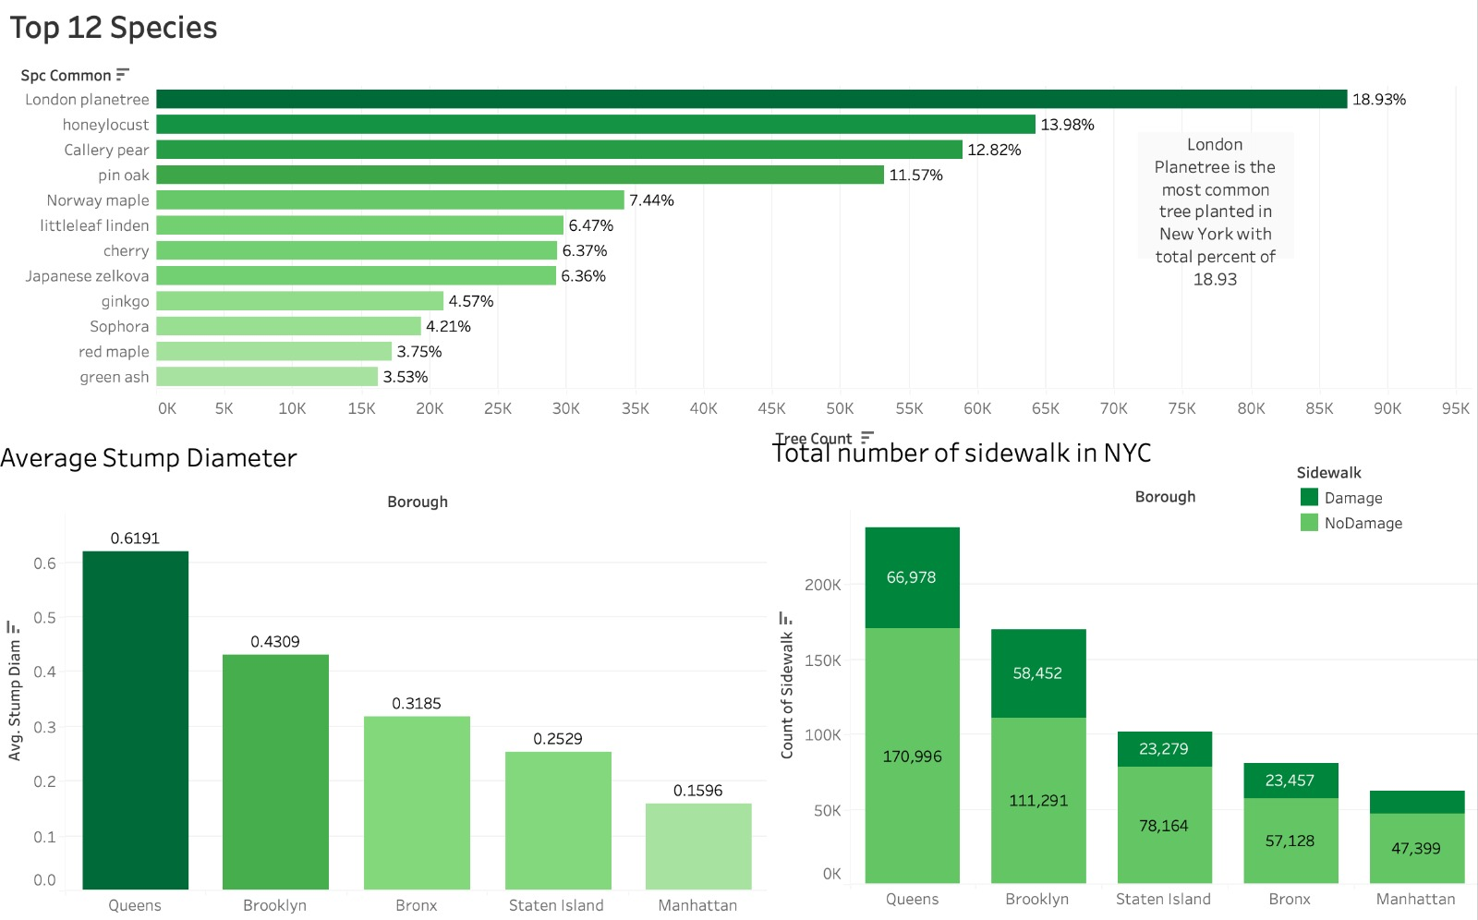
Top 12 species and their stump diameter and total number of sidewalk in New York city.

Slide 8
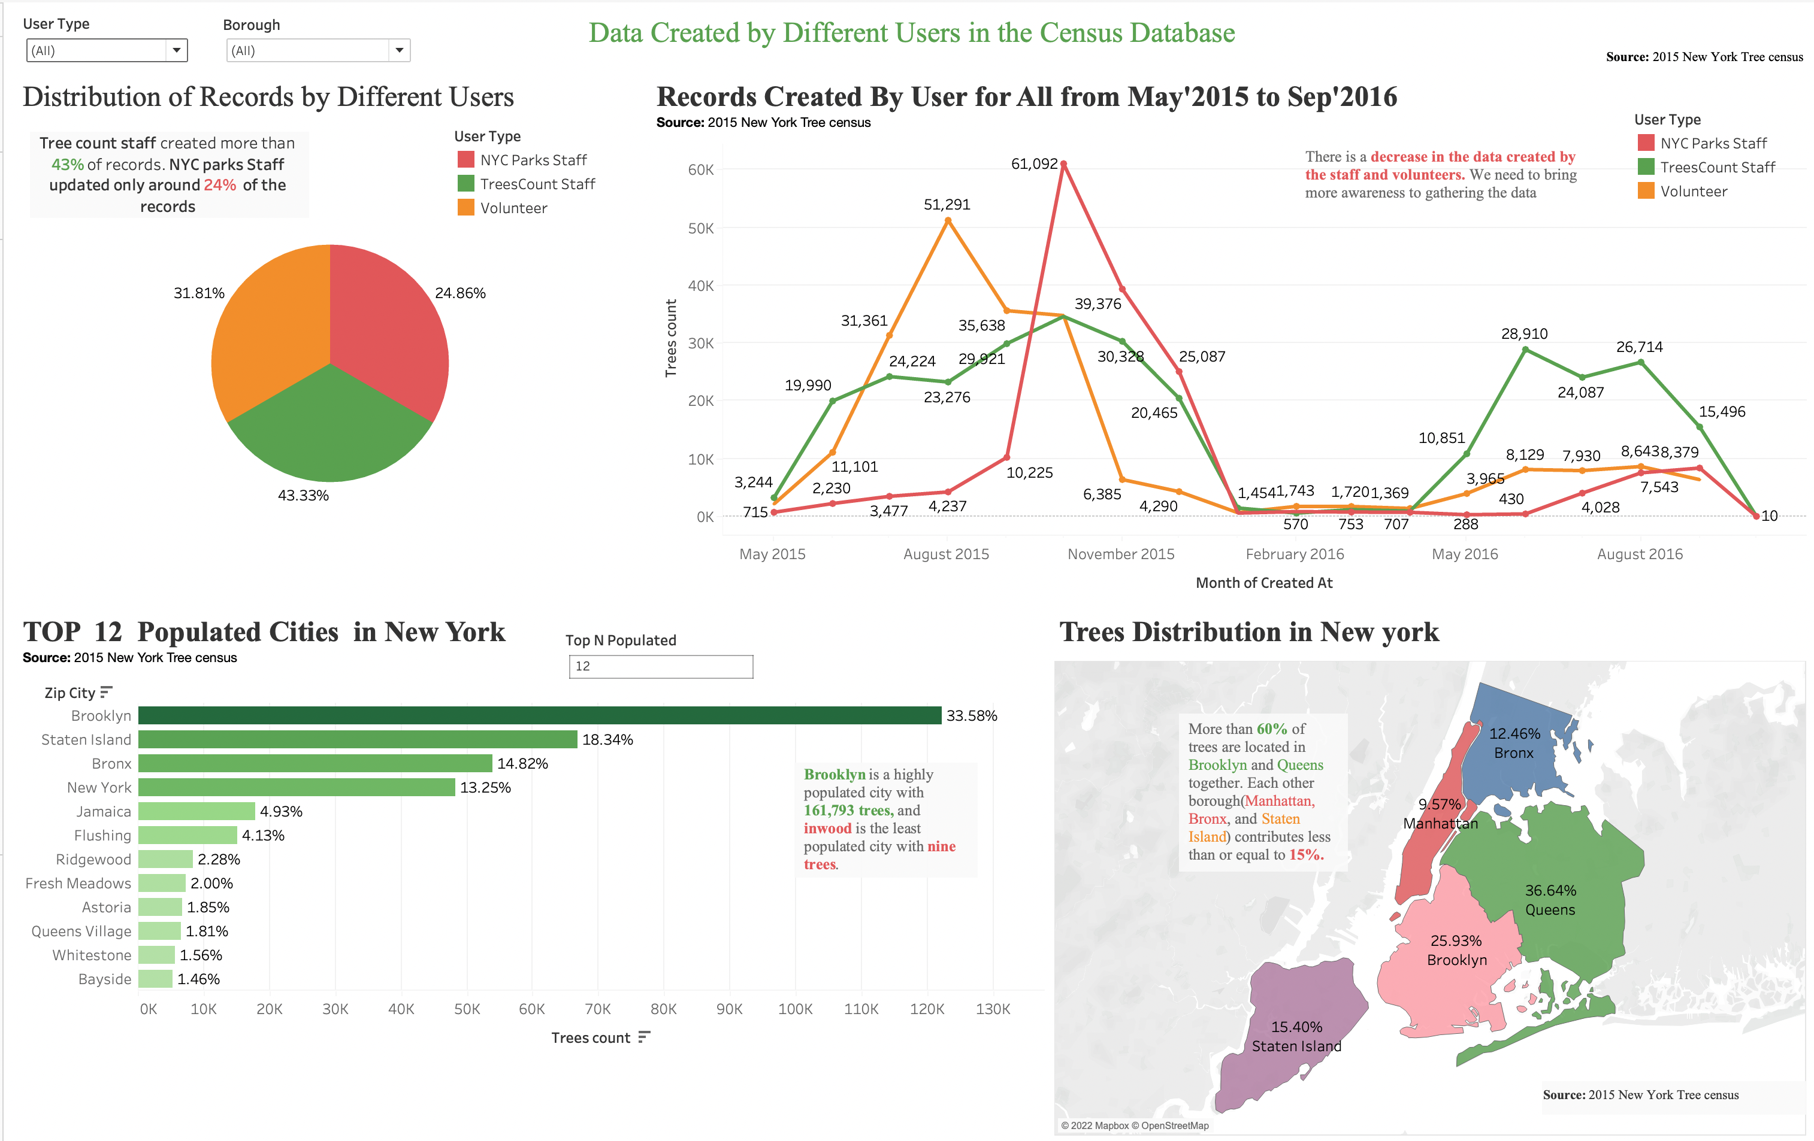

Slide 9
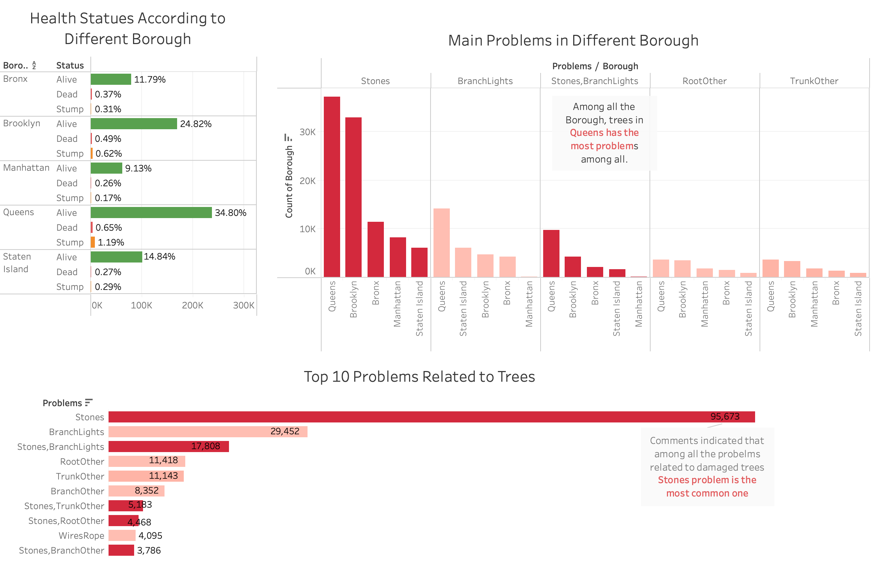
What are the most common Problems faced by Trees?

Slide 10
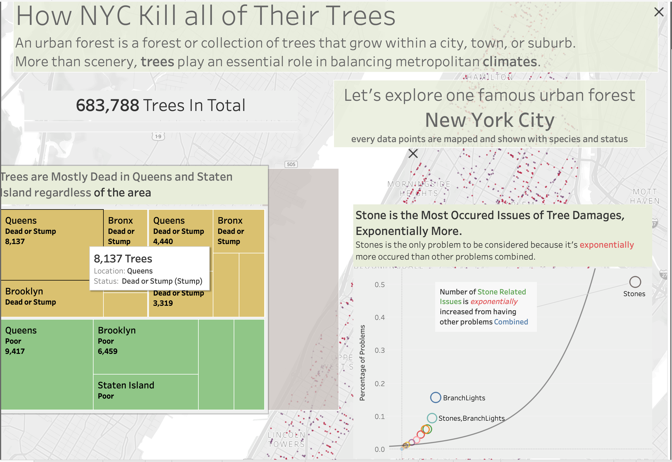

Slide 11
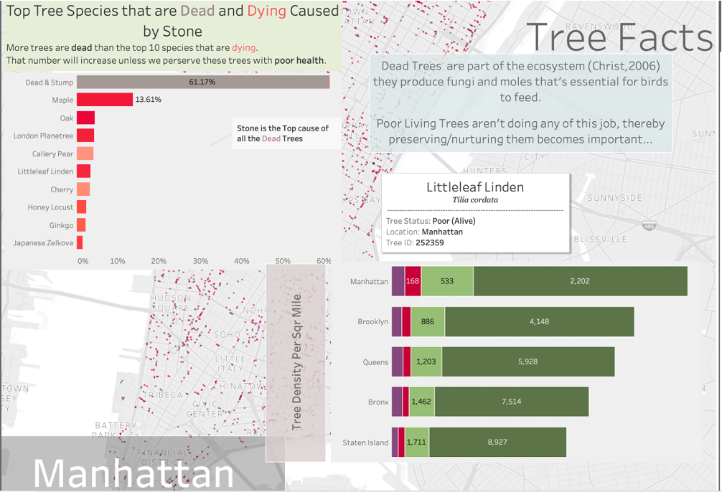

Slide 12
Conclusion
Good health trees are maximum in 2015 and then steeply reduced in Feb 2016 and the most common species found in NYC was London Planetree .
NYC parks staff contributed fewer records creation in the census database than volunteers and tree count staff. Records creation reached its peak in Oct 2015 and significantly decreased by Sep 2016.
The maximum problems are seen in Queens, which is accurate as the most number of trees are also present in Queens.
The most type of problems that is seen is of stones and again in Queens.
Stones is the top problem which occurred exponentially more than other problems combined.
Manhattan has the most tree density per square mile, regardless of dying or dead trees.
Queens and Brooklyn still occupied with most dying trees caused by stone, and they should be the first to be fixed.

